Slide 1
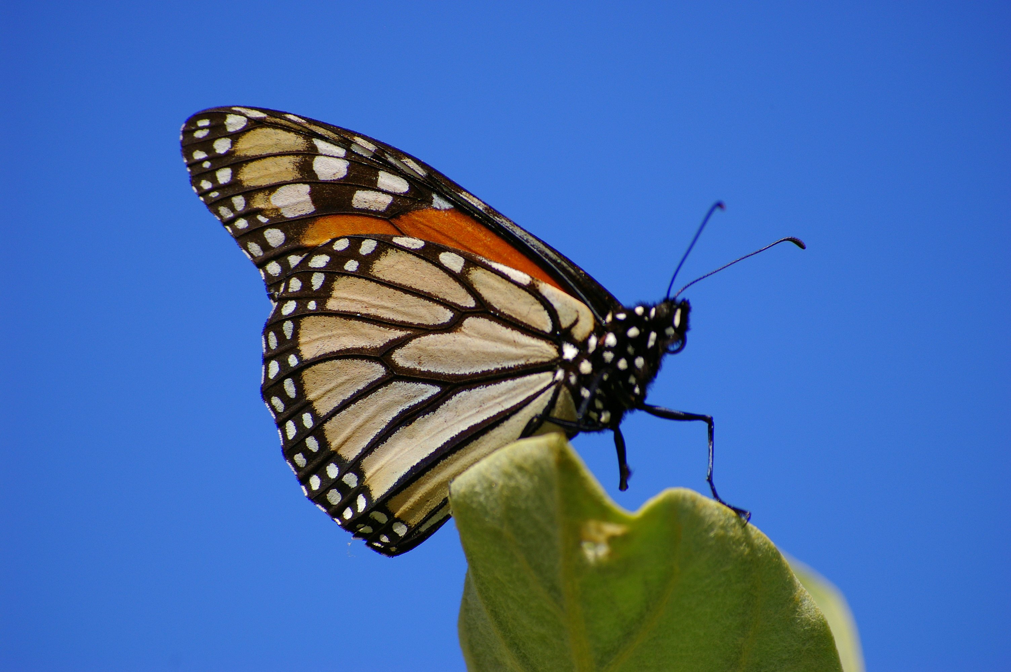
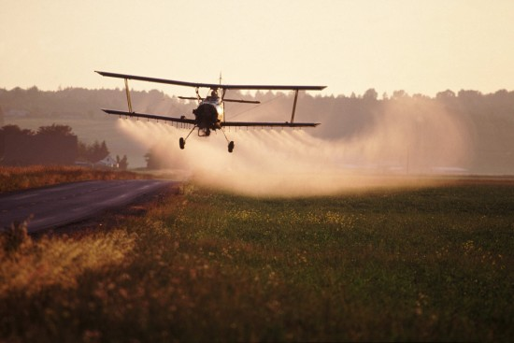
Current and future anthropogenic drivers
on eastern N. American monarch dynamics
Sonia Altizer, Becky Bartel, Reba Batalden,
Leslie Ries, & Monte Sanford

Slide 2
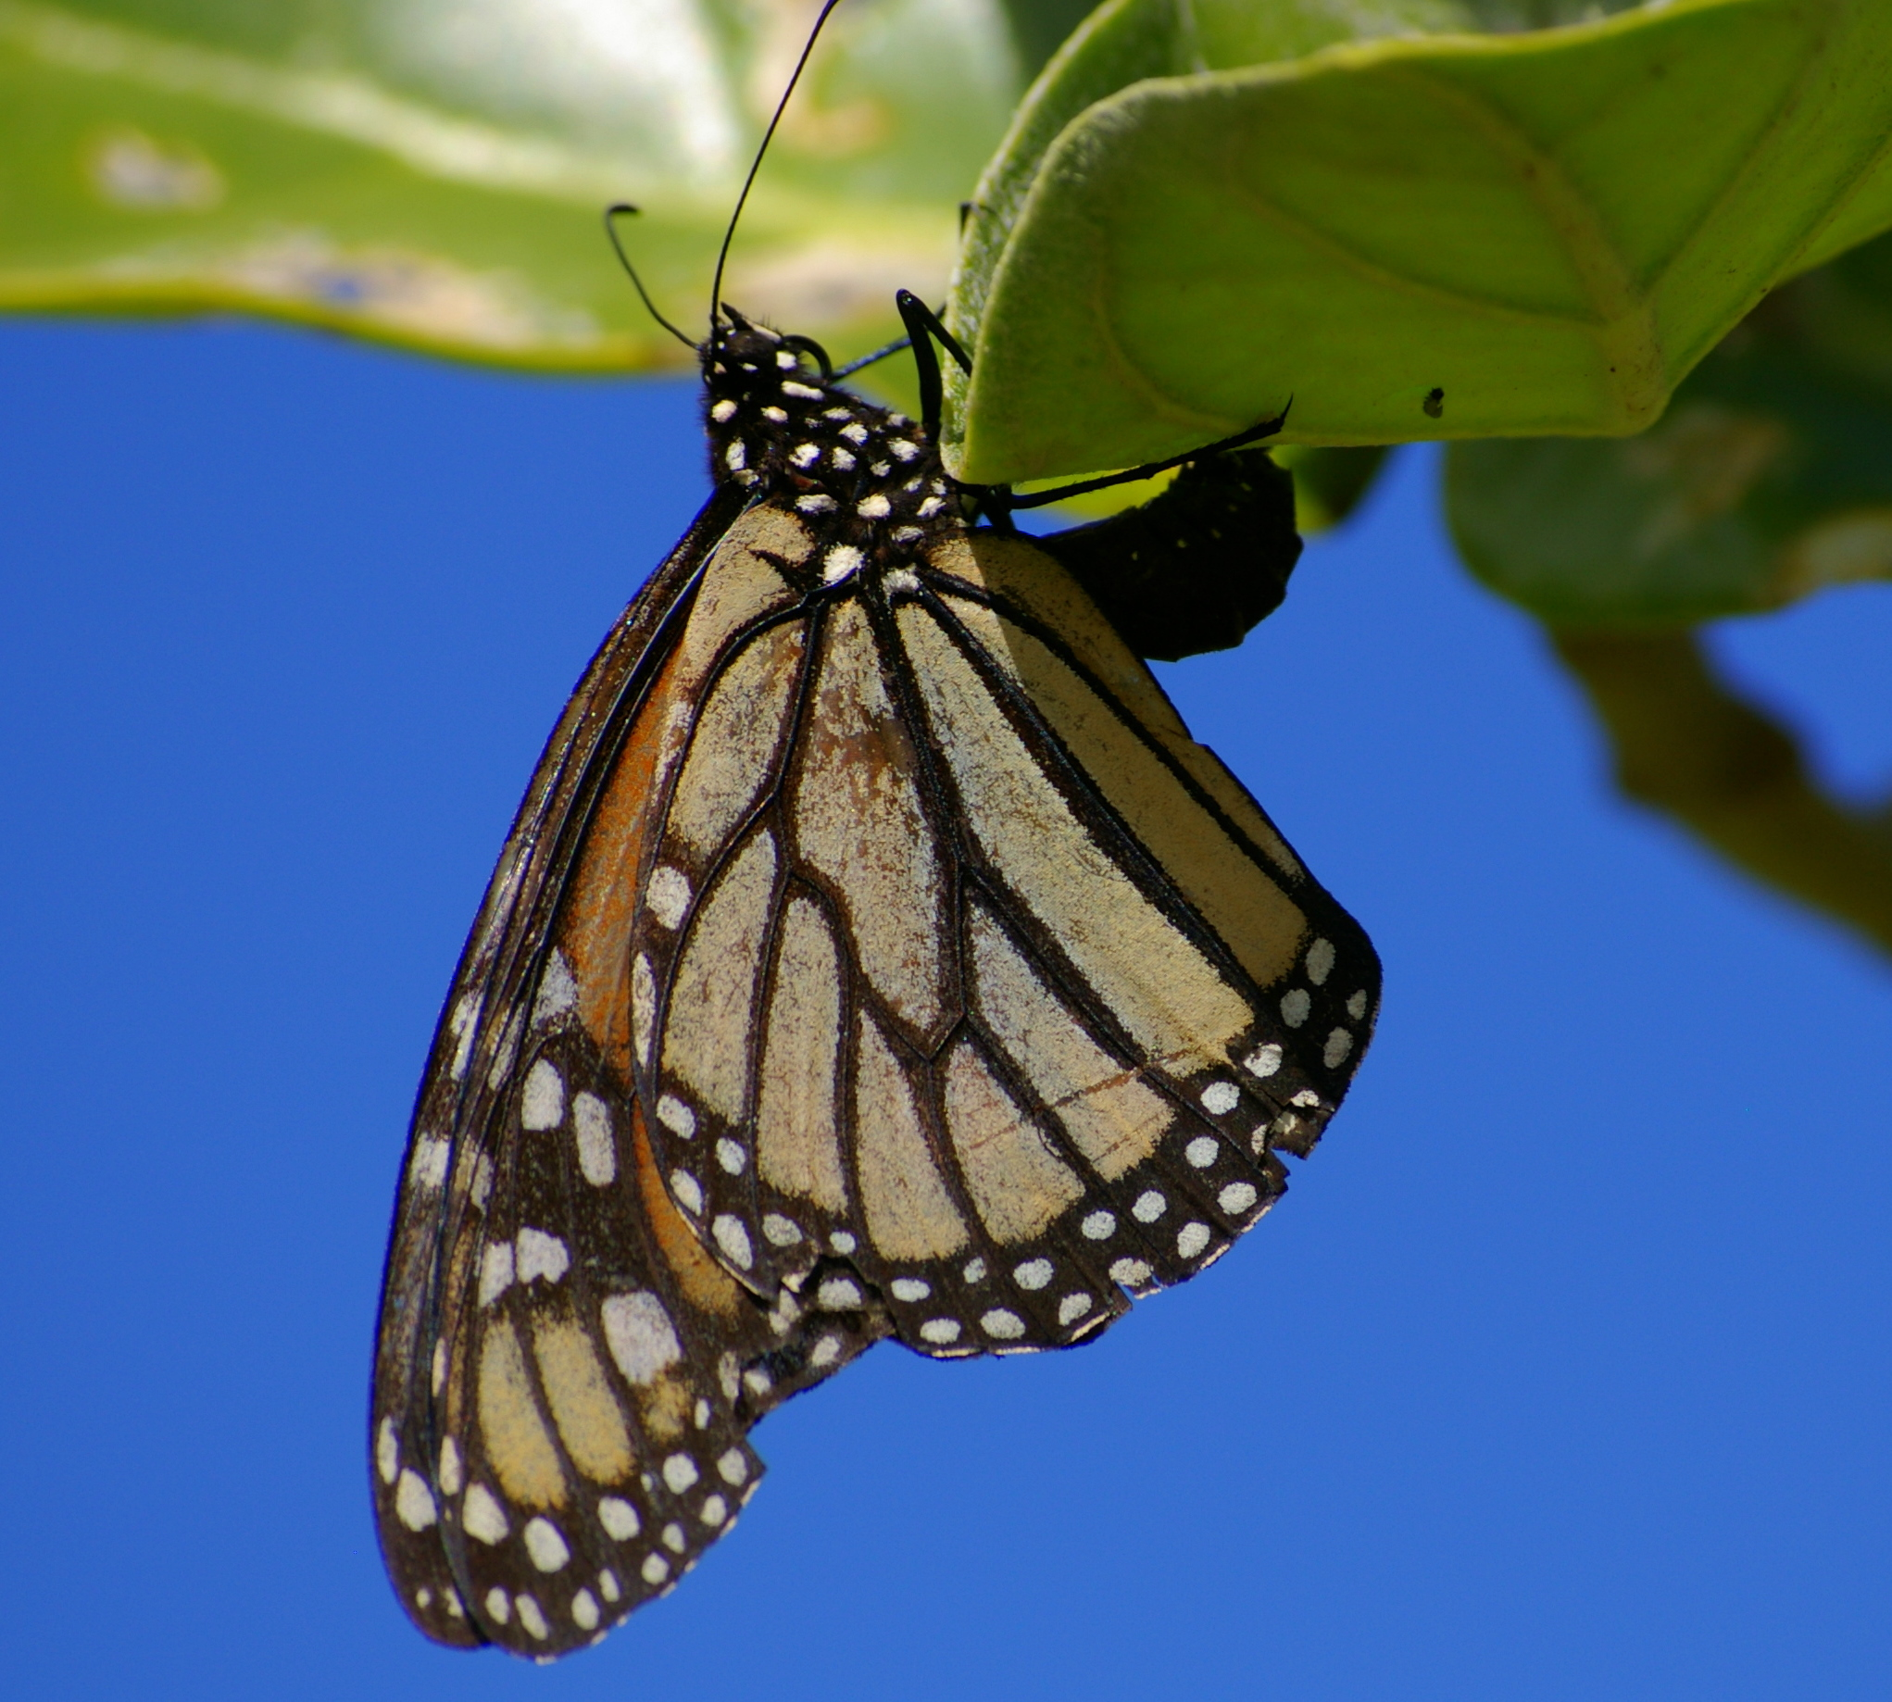
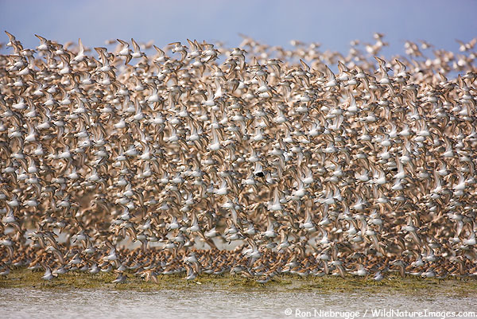
Develop conceptual model
Climate
Commercial release of monarchs
Land use/change
Nectar resources availability

Slide 3
Questions
What is the expected effect of climate change on monarch wintering and breeding habitats, and patterns of annual migration?
How will changes in land use and agricultural practices affect monarchs at different stages of their annual life cycle?
What are the expected changes in nectar availability and how will this influence monarch migration?
What is the contribution of the butterfly breeding industry on monarch distributions, abundance and disease?
Interactive effects

Slide 4
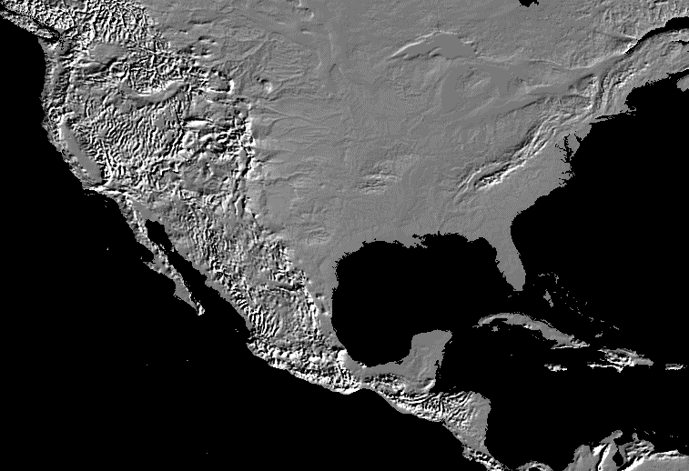
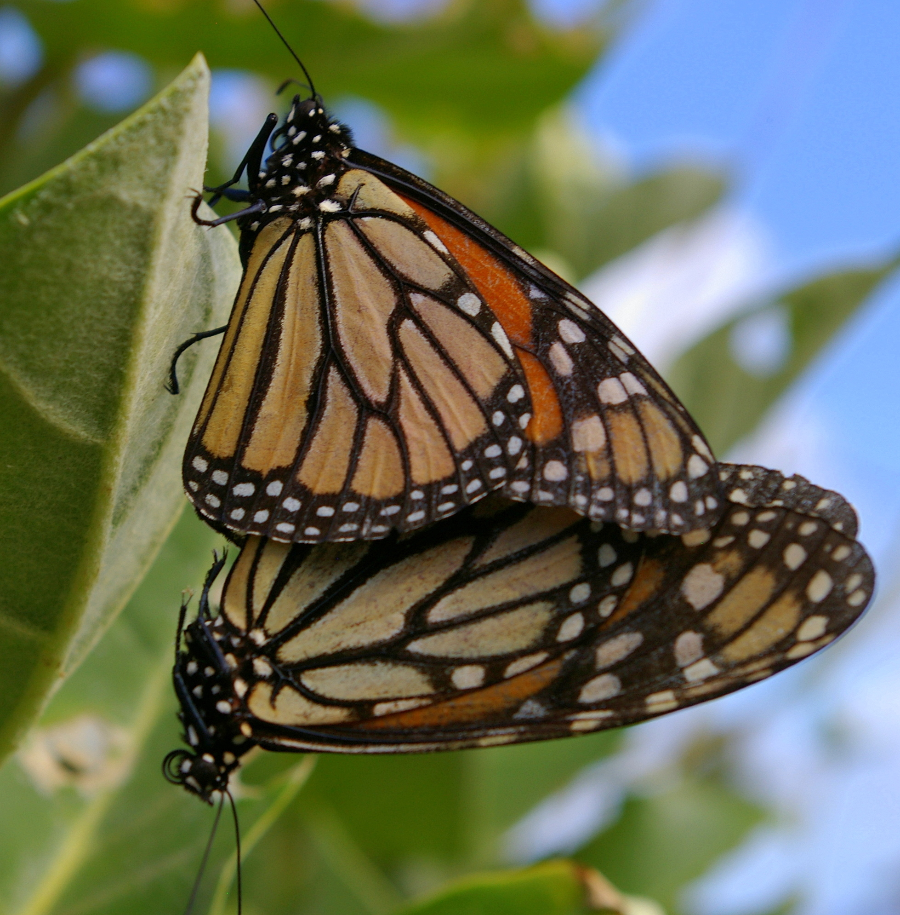
Spatiotemporal scales
Spatial
  Site
  Region
  Continental
Temporal
  Breeding
  Migratory
  Overwintering

Slide 5
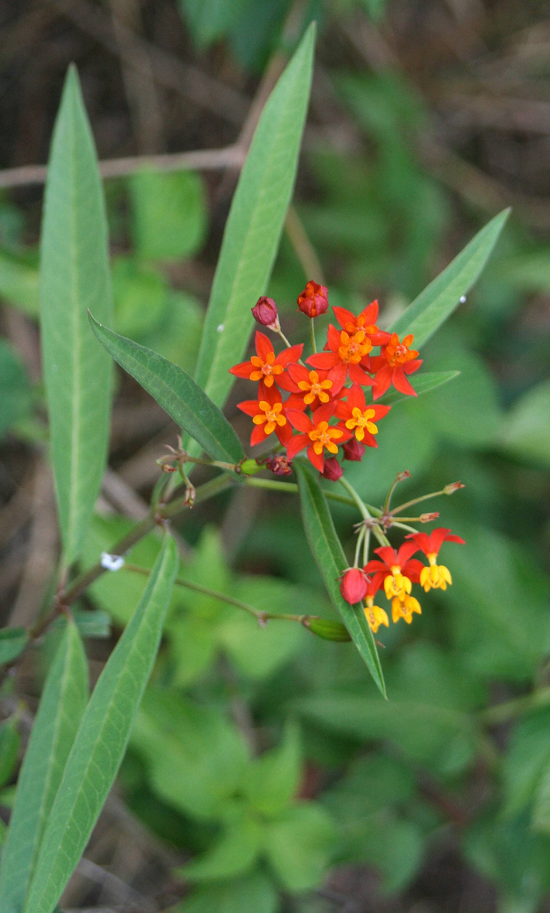
Climate change
Objectives
  Temperature and precipitation
    Distribution of monarchs and host plants
  Phenology
    Host plants, nectar resources, monarchs
Data needs/gaps
  Response variables
    Monarch counts (NABA, Ohio, etc.)
    Disease (OE, parasitoids)
  Explanatory variables
    Weather
    Host plant distribution
    Nectar resources (National Phenology Network)
Immediate plans/goals

Slide 6
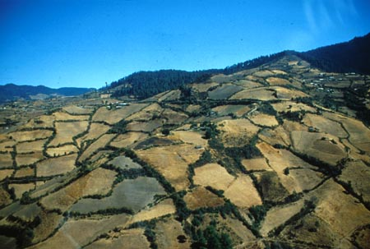
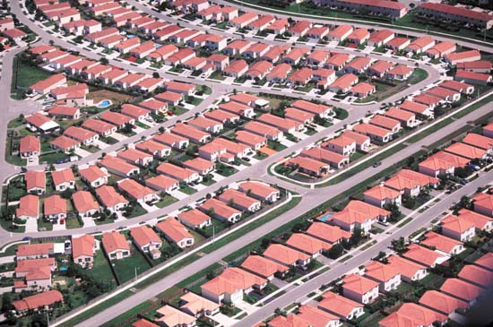
Land use/change (site-scale)
Objectives
  Habitat/resource availability
    Different temporal scales
Data needs/gaps
  Response variables
    Monarch counts (NABA, MLMP, etc.)
    Disease (OE, parasitoids)
  Explanatory variables
    Land cover/use (EPA NLCD)
      Ag categories (row crops, hay)
    Ag practices (GM crops, pesticide

Slide 7
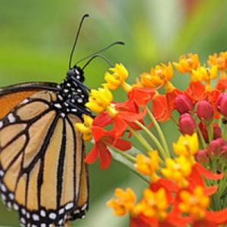
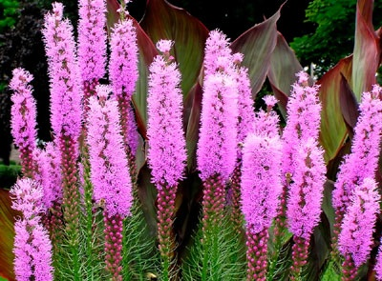
Nectar/host plant availability
Objectives
  Habitat/resource availability
    Fall migration (garden effects)
Data needs/gaps
  Response variables
    Monarch counts (NABA, MLMP, MW)
  Explanatory variables
    Nectar resources (National Phenology Network)
    Host plant distribution
      Natural vs. garden
Immediate plans/goals

Slide 8

Monarch releases
Objectives
  Monarch occurrence
Data needs/gaps
  Response variables
    Aberrant monarch sightings (JN, counts)
    Disease (OE)
  Explanatory variables
    Commercial producers (USDA permits)
    Annual sales of producers
Result highlights
  Long-term trends of OE (tied to growth in industry?)
Planned manuscript
  Stand-alone review paper (idea-rich, data-poor)

