Slide 1
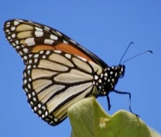
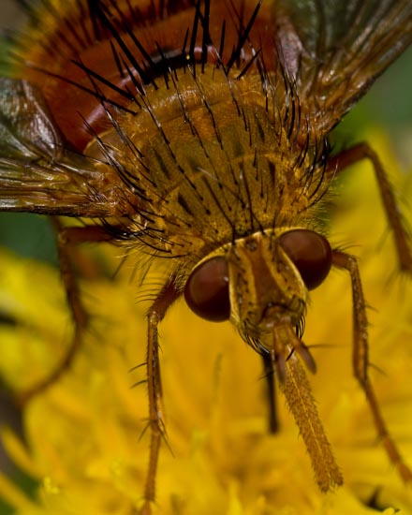
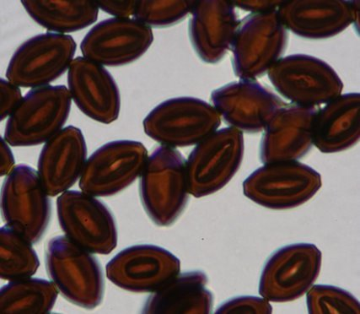
Natural enemies of monarch butterflies
Sonia Altizer, Becky Bartel, Dennis Frey, & Karen Oberhauser

Slide 2
Questions
What is causing the decrease in OE in western N Am populations?
What is causing the increase in OE in eastern N Am populations?
What are the relationships between parasitoids and OE prevalence?
What are the effects of patch dynamics on natural enemy dynamics (patch isolation, proximity, dispersion)?
What are the effects of different predators on monarch dynamics?
What drives rates of parasitism?

Slide 3
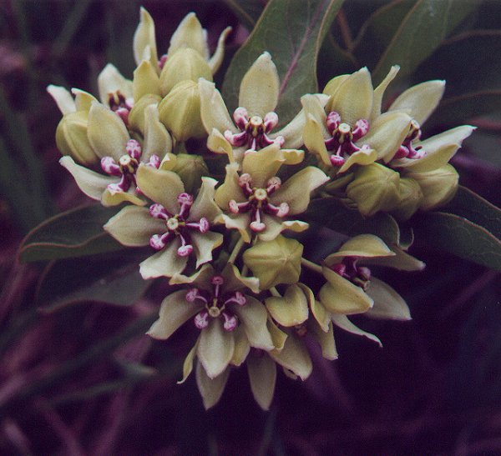
OE patterns of infection in the West
Working questions for hypotheses:
Are patterns of OE infection density-dependent?
  Horizontal transmission is density-dependent
Are patterns on OE infection driven by are external factors (i.e., milkweed distributions/availability/condition, drought, releases)?
Data needs/gaps
  Response variables
    Monarch density (DF, Xerces)
    Disease prevalence (OE)
  Explanatory variables
    Weather variables (precip)
    Milkweed maps
    Releases (IBBA)

Slide 4
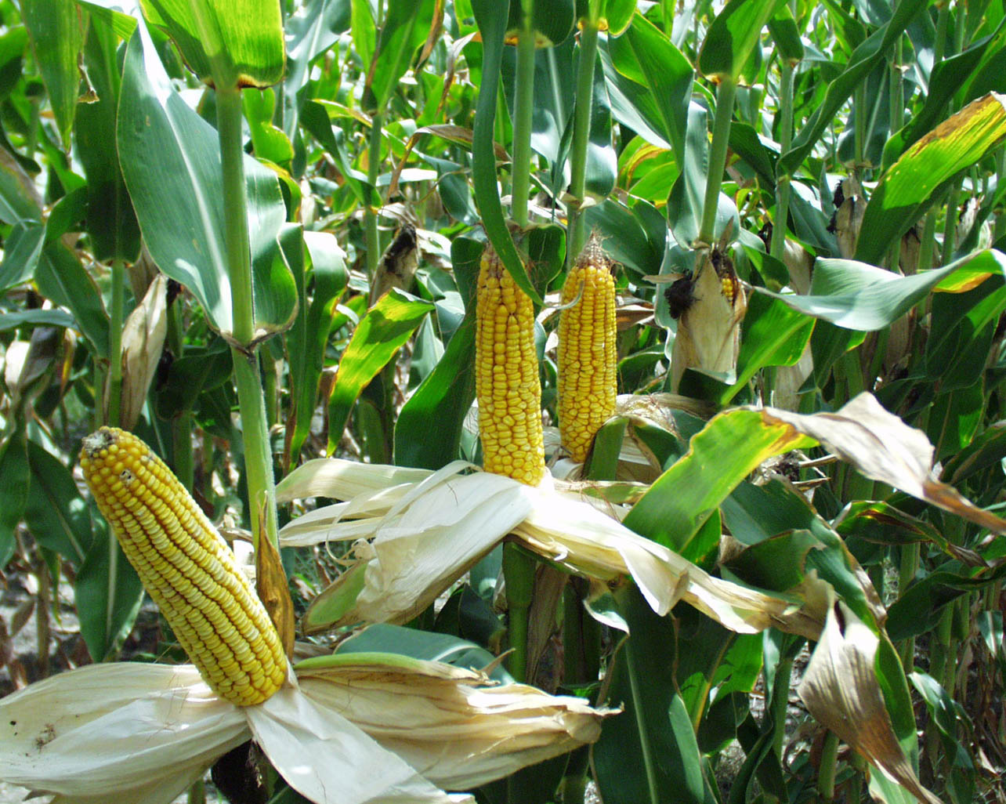
OE patterns of infection in the East
Working questions for hypotheses:
Does the decrease of monarch productivity in the corn belt limit migratory culling (increase OE)?
Does winter breeding along the Gulf coast increase levels of OE infection?
  Cold winters decrease levels of OE
Data needs/gaps
  Response variables
    Monarch occurrence, density (JN, MLMP)
    Disease prevalence (OE)
  Explanatory variables
    Weather variables (temp)
    Agriculture stats/maps

Slide 5
Relationships between parasitoids/OE
Why do Costa Rica and Puerto Rico populations have low OE?
Working questions for hypotheses:
Are infections density-dependent?
What are the interactive effects?
  OE infected monarchs are more susceptible to parasitoids
Data needs/gaps
  Response variables
    OE prevalence
    Parasitoid data
  Explanatory variables
    Monarch density

Slide 6
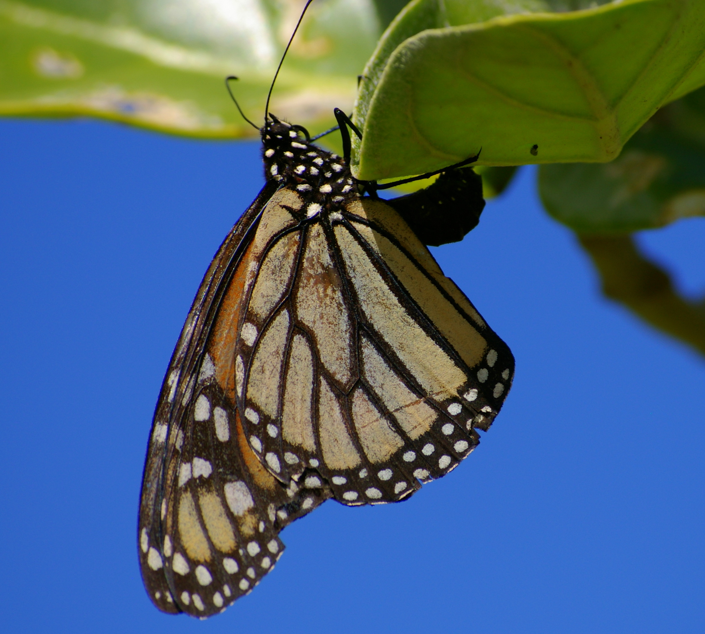
Patch dynamics
Working questions for hypotheses:
How do patchy milkweed distributions affect OE and parasitoid levels?
  Infection levels increase with host plant patchiness
Data needs/gaps
  Response variables
    Disease prevalence
  Explanatory variables
    Milkweed maps
    Patch/landscape characteristics

Slide 7
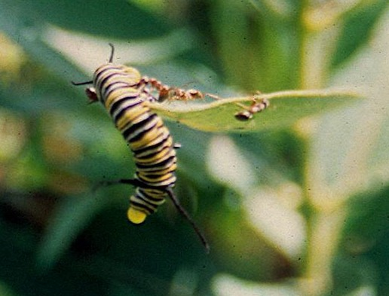
Predators
Working questions for hypotheses:
What are the effects of different predators on monarch dynamics?
  Review
Data needs/gaps
  Response variables
    Monarch survival (MLMP)
    Monarch density (counts)
  Explanatory variables
    Predator occurrence/abundance (MLMP, various)
      Ants
      Lacewings
      Earwigs

Slide 8
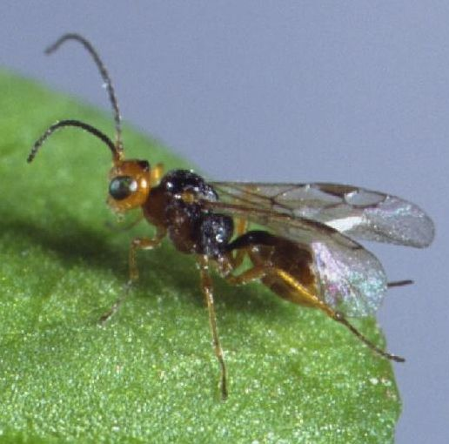
Parasitoids
Working questions for hypotheses:
What drives rates of parasitism?
  Infection levels are density-dependent
  Infection levels increase with other host availability
  Infection levels increase with winter survival
Data needs/gaps
  Response variables
    Parasitoid levels
  Explanatory variables
    Weather
    Other butterfly host density
    Monarch density (MLMP, counts)

