Slide 1
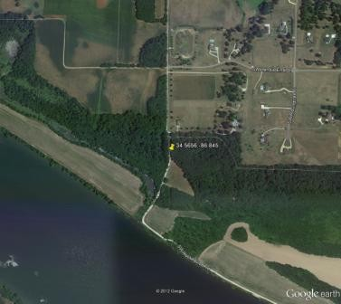
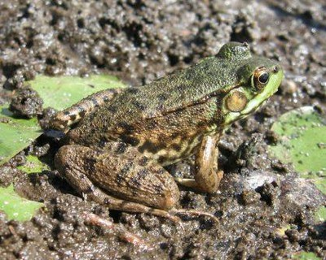
Roads, Toads, and Nodes
Collaborative course-based research on amphibian landscape ecology

Slide 2
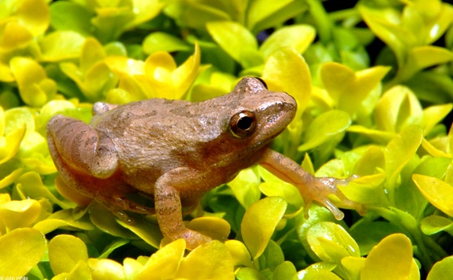
Project goals:
Provide real research experience for students in biology/ ecology courses
Improve students’ ability and confidence in organizing and compiling data
Improve students’ understanding of landscape ecology/ GIS
Generate new findings about the effects of roads and other landscape features on amphibian populations (i.e. do science)

Slide 3
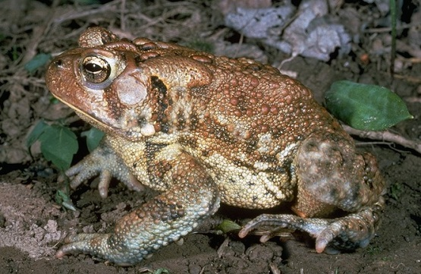
Project structure:
10 classes, each assigned one more states
Amphibian survey routes divided among students
Two students compile data for each survey route – students compare and seek consensus
Each class analyzes the data for their own state(s)
Representatives from each class come to NCEAS to compile and analyze the group data

Slide 4
Data used in the project:
Data on amphibian presence/absence from volunteer surveys within Eastern and Central North America.
Landuse data from the National Landcover database
Wetland data from the National Wetlands Inventory
Road data from Open Street Map, an open-source analog to Google Maps

Slide 5
About the amphibian surveys:
North American Amphibian Monitoring Program, administered by the U.S. Geological Survey
Survey routes, divided into 10 stops
At each stop, the surveyor listens for frog calls
Surveys are generally carried out 3 times per year, sometimes over as many as 10 or 12 years
Survey data are not without error – for example, amphibians may be present but not calling, or people may just confuse the calls of different species
We will work with 4 of the 10 stops on each route (so that stops are sufficiently far apart)

Slide 6
Your job:
For the routes that have been assigned to you:
Summarize amphibian data for each stop
Use GIS software to build a map for each stop
Use this map to calculate and record a number of landscape variables (e.g. the density of roads at a site, whether forest is adjacent to wetlands, etc.)

Slide 7
Frequently asked questions:
Q: Why me? (why us?)
A: Your class has been selected because of your instructor’s expertise on the subject matter.
Q: What’s the point of having two people do each route? Isn’t that needlessly repetitive?
A: Having two people do each route is the only way we know if the results coming back in are valid. Even very experienced scientists frequently build in this kind of replication to validate their results.
Q: There’s no way I can do all this. (OK, this is not really a question).
A: You can do this! We’ve had some students give all the protocols a trial run with no instructor to help them, and they’ve been able to figure it out.
Q: What if I can’t figure something out?
A: We know you’ve never done this before and we expect that everyone will have questions. If you can’t figure something out, post your question on the Discussion Board, or ask your instructor. It’s OK to leave entries blank, but please don’t guess (or estimate) if you haven’t been able to figure something out.

Slide 8
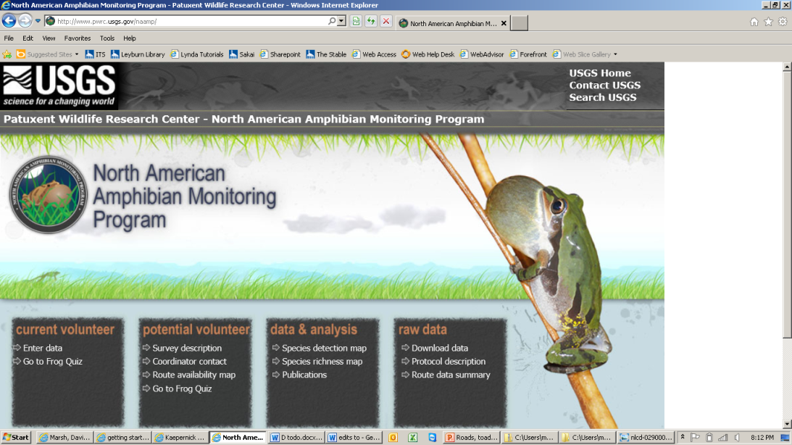


Thanks in advance for all your hard work on this project!

