Slide 1
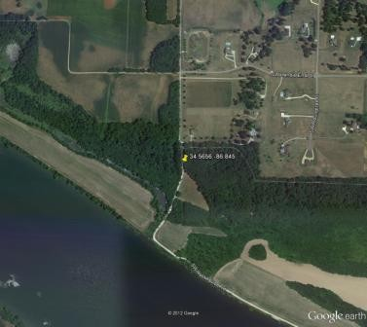
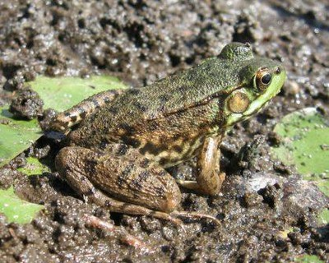
Roads, toads, and nodes: linking undergraduate ecology courses to study the impacts of land use on amphibian populations
David Marsh
Washington and Lee University

Slide 2


Slide 3

Project basics:
Amphibian data from the North American Amphibian Monitoring Program
Compile landscape variables for NAAMP survey locations
Analyze relationship between landscape variables and presence/absence, species richness

Slide 4
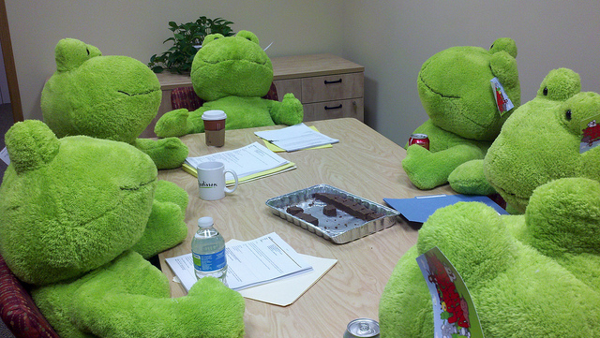
Project structure:
9 participating classes
Each class completed routes from their assigned state(s)
Reps from each class met at NCEAS in April to compile data across classes
Analyzed combined data in April and May

Slide 5
Education positives:
“I liked that I got to work on actual research. To see how data is compiled and analyzed”
“I loved the whole thing. The research was fascinating, the Qgis program was really fun to learn and use, and the analysis portion of this research brought forth some interesting results”
“I thought it was cool to be part of a large national research project.”
“It was a wonderful learning experience. I like learning about qGIS, data compiling, and even the statistic analysis.”
“I liked that I was actually contributing to a real study, not just a hypothetical study in a class. I was much more careful with data collection and analysis knowing that real answers to the research questions might actually be found at the end of the project.”

Slide 6
Education negatives:
“A little boring and repetitive but thats to be expected given the work we were doing.”
“The guidelines and guidance was not there at all. I initially had no idea how to even begin.”
“Some students weren't very interested, and it dragged the rest of the group down.”
“I really disliked how I seemed to be one of the few students who actually understood the objective and how to do the project. The other students I was working with did not understand the majority of the directions or purpose of the project… Maybe the directions could be written in the language of a 1st grader so my classmates could better understand them.”
“add in fireworks and it might become slightly interesting.”

Slide 7

Developing a plausible take-home from the project
STORY 1: “Ubiquitous effects of roads and traffic on frog and toad populations across the Eastern and Central United States.”
STORY 2: Hopelessly confounded variables measured by unqualified observers, compiled by disinterested undergraduates, and analyzed with black box approaches

Slide 8

North American Amphibian Monitoring Program (NAAMP)
Volunteer surveys of frogs and toads across 24 states in the Eastern and Central U.S.
Surveyors are assigned randomly-chosen routes and select stops based on visual confirmation of aquatic habitats within 200 m
Ten stops are chosen per route, each at least 0.5 km from the previous stop
Routes are surveyed by car 3 times per year in the spring and summer
Surveyors record species heard at each stop (calling index), along with weather-related variables
Surveyors also record the number of cars passing by during the 5 minute survey and presence of noise

Slide 9

Frog and toad summary variables:
Presence 1/Presence 3 for each species
Species richness 1/Species richness 3
Total surveys
Number of surveys with noise
Presence/ richness variables for quiet surveys only

Slide 10
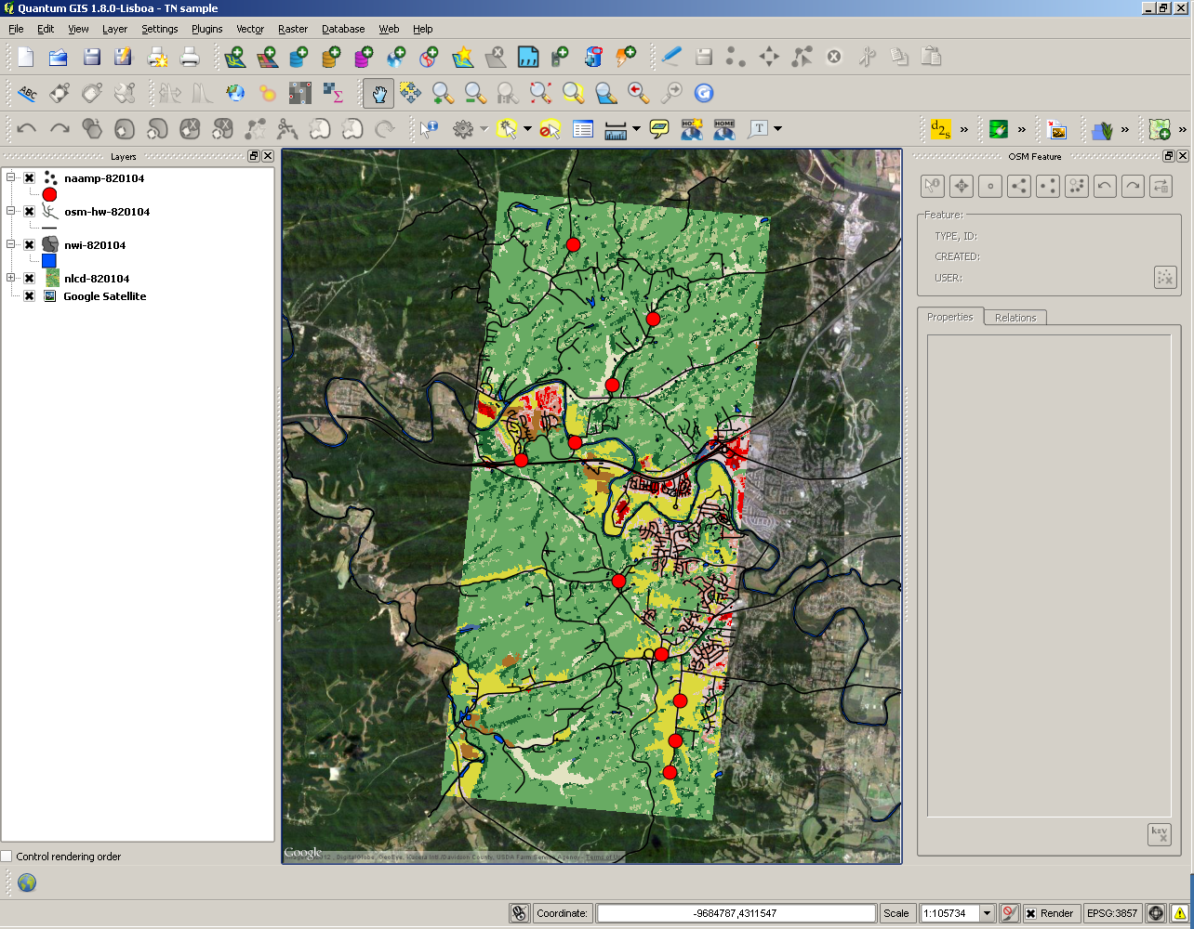

Slide 11
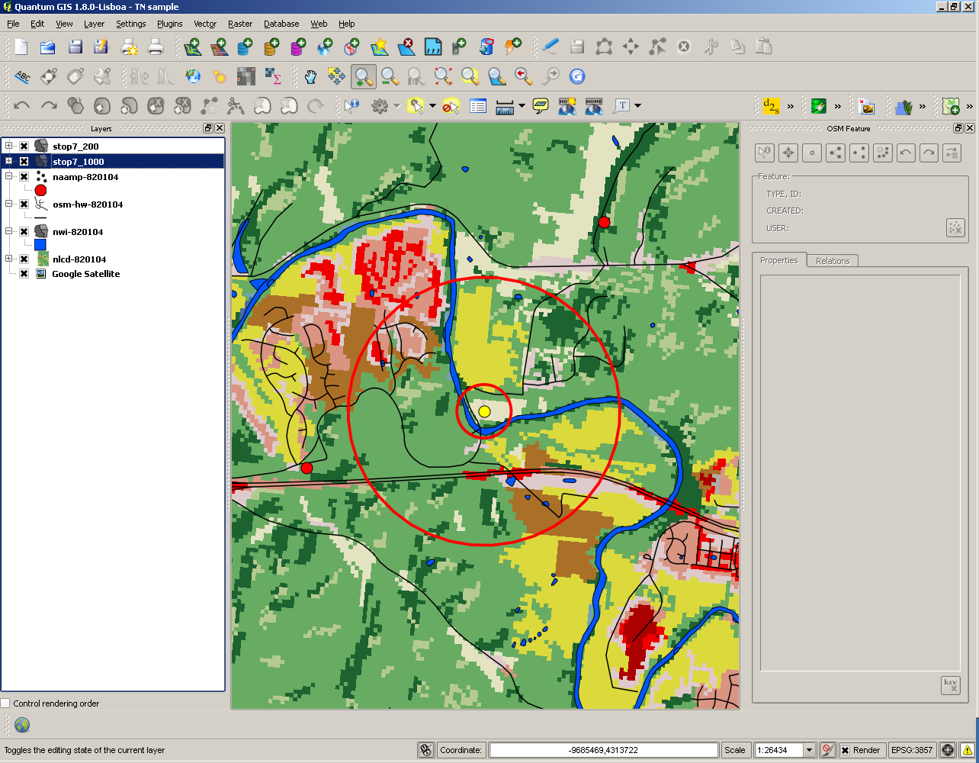

Slide 12
Landscape variables
Discrete/continuous:
Car mean
Road length
Proportion developed
Proportion agriculture
Proportion forest
Number of wetlands
Wetland area
Habitat richness (<200m and < 1000m)
Binary:
Adjacent forest
Isolated wetland
Wetland/Road/Forest configuration
Wetland/Dev/Forest configuration
Wetland/Ag/Forest configuration

Slide 13
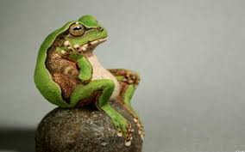
Questions:
1) What landscape factors best explain amphibian species richness and presence/absence of individual species?
2) Are the negative effects of roads on amphibians more associated with the number of roads in the landscape or with the local volume of traffic?
3) Are roads or other land uses particularly bad for amphibian populations when they separate wetlands from uplands?
4) Are amphibians more sensitive to the amount of different kinds of habitats in the landscape or the particular arrangement of those habitats?

Slide 14
A priori model set (12 models)
Full model (Proportion forest, proportion developed, wetland area, road length, traffic)
Null model
5 single variable models
“Roads”: road length + traffic
“Detection”: total surveys, and noise level
“Landcover”: variables above sans traffic
“Land-nat”: prop forest + wetland area
“Total development”: prop developed+ road length+ traffic + noise level

Slide 15
Individual species analyses
Eliminate observations from outside species range
Estimate # of surveys to achieve detection rate > 90%, and include only stops with at least this many surveys
Analyze presence/absence relative to fixed effects of interest and a random effect for route

Slide 16
Hyla chris/vers
0
.
1
8
.
y
0
t
i
l
i
b
a
b
o
r
6
P
.
n
0
o
i
t
c
e
t
e
D
4
e
.
v
0
i
t
a
l
u
m
u
C
2
.
0
0
.
0
5
10
15
Sur
v
e
ys

Slide 19
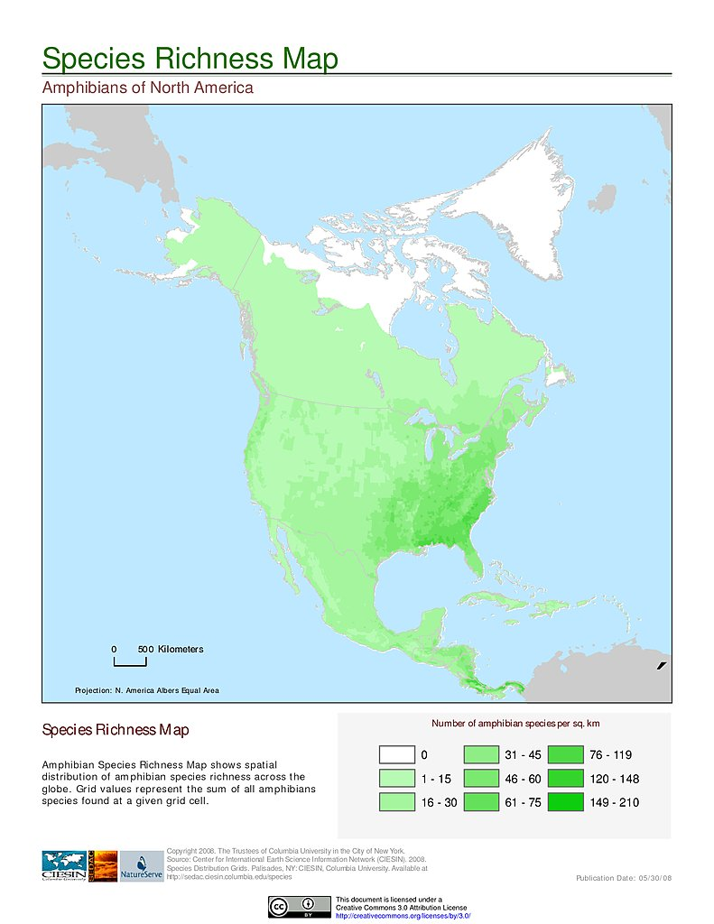

Slide 20
Species richness analysis
Cut stops with fewer than 9 surveys
Poisson regression of total surveys and net primary productivity (NPP) on raw richness
Analyze residuals with a mixed model including fixed effects of interest and route-specific random effect

Slide 21
Ancillary richness analyses:
Richness with no-noise data only (and noise level excluded as an explanatory variable)
Richness based on a subset of species and surveys with estimated detection rates > 90%
Presence/absence of at least one “rare species” – i.e. >100 potential sites but <20% detections
Structural equation model including inter-related explanatory variables

Slide 22
PROP DEVELOPED
-
NOISE LEVEL
SPECIES RICHNESS
(residuals from NPP)
-
CAR MEAN
-
ROAD LENGTH

Slide 23
SPECIES BEST MODEL OTHER COMP. MODELS BEST SINGLE VAR. MODEL
Anaxyrus amer. FULL` TOTDEV TRAFFIC (NEG.)
Hyla cinerea FULL --- PROP_FOR (NEG.)
H. chris./vers. FULL TOTDEV PROP_DEV (NEG.)
H. gratiosa FULL LANDNAT, LANDCOV, FOR PROP_FOR (NEG.)
Lithobates cates. FULL --- PROP_DEV (NEG.)
L. clamitans FULL --- TRAFFIC (NEG.)
L. palustris TOTDEV TRAFFIC, FULL, DETECT TRAFFIC (NEG.)
L. sphenocephalus LANDNAT --- PROP_FOR (NEG.)
L. sylvatica FULL LANDNAT WET_AREA (POS.)

Slide 24
VARIABLE BEST MODEL OTHER COMPETITIVE MODELS BEST SINGLE VAR MODEL
SPECIES RICHNESS FULL --- TRAFFIC (NEGATIVE)
(residuals of npp+tot-surv)
SPECIES RICHNESS FULL --- TRAFFIC (NEGATIVE)
(noise = ‘N’ only)
SPECIES RICHNESS FULL --- TRAFFIC (NEGATIVE)
(spp. w/90% detection prob)
RARE_PRES FULL --- TRAFFIC (NEGATIVE)
(presence of at least one rare species)

Slide 29
MODEL COMPARISON FOR SPECIES RICHNESS

Slide 30
Parameter estimates for FULL model (Species richness)
Fixed effects: Estimate Std. Error t value
(Intercept) 0.185165 0.105740 1.751
PROP_DEV 0.096692 0.411846 0.235
PROP_FOR -0.209683 0.139934 -1.498
CAR_MEAN -0.017617 0.005775 -3.051
ROAD_LEN -0.025850 0.009054 -2.855
WET_AREA 0.160484 0.074297 2.160

Slide 32
WHAT’S MORE IMPORTANT, ROAD LENGTH OR TRAFFIC (OR BOTH)?
VARIABLE TRAFFIC VERSUS ROAD-LENGTH BEST OVERALL MODEL
SPECIES RICHNESS TRAFFIC BOTH (TRAFFIC + ROAD-LEN)
(residuals of npp+tot-surv)
SPECIES RICHNESS TRAFFIC BOTH (TRAFFIC + ROAD-LEN)
(noise = ‘N’ only)
SPECIES RICHNESS TRAFFIC TRAFFIC
(spp. w/90% detection prob)
Anaxyrus americanus TRAFFIC BOTH
Hyla cinerea TRAFFIC BOTH
Hyla chris./vers. TRAFFIC BOTH
Hyla gratiosa TRAFFIC TRAFFIC
Lithobates catesbeiana TRAFFIC BOTH
Lithobates clamitans TRAFFIC BOTH
Lithobates palustris TRAFFIC TRAFFIC
L. sphenocephalus SIMILAR SIMILAR
L. sylvatica TRAFFIC TRAFFIC

Slide 33
Are roads or other land uses particularly bad for amphibians when they separate wetlands from forest?
SIGNIFICANT EFFECTS FOR HABITAT SPLIT, α= 0.05:
HYCI W/D/F, HYCV W/D/F, LISY W/D/F, LISY W/R/F.
SIGNIFICANT EFFECTS WITH A SEQUENTIAL BONFERRONI (i.e. correcting for the large number of tests we’re performing): NONE

Slide 34
What’s more important, habitat composition or habitat configuration?
Compare:
Model containing habitat composition variables (PROP_FOR, WET_AREA, PROP_AGR, PROP_DEV, ROAD_LEN) to
Model containing habitat configuration variables (ADJ_FOR, ISO_WET, W/A/F config, W/D/F config, W/R/F config)
COMPOSITION MORE IMPORTANT FOR: SPECIES RICHNESS, RARE_PRES, ANAM, HYCI, HYCV, LICA, LICL, LISY
CONFIGURATION MORE IMPORTANT FOR: LISP
SIMILAR (NOT ENOUGH DATA) FOR: HYGR, LIPA

Slide 35

Roads are bad for amphibians

Slide 36
But…
Tons of variability in the data (i.e. effects are weak)
Traffic, noise, and detection are all somewhat confounded
Traffic data not really collected for this purpose
Roadside surveys present problems for detecting road effects?

