Slide 1
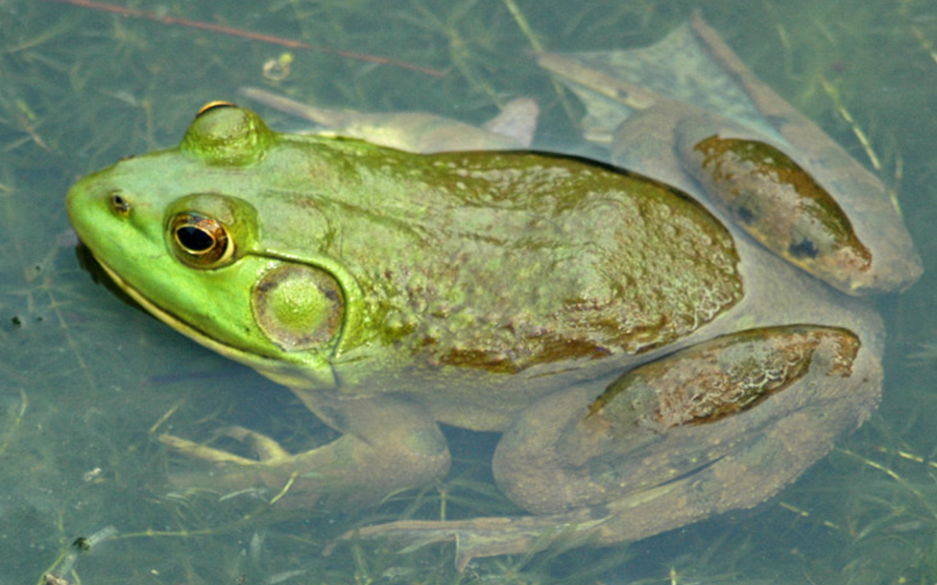
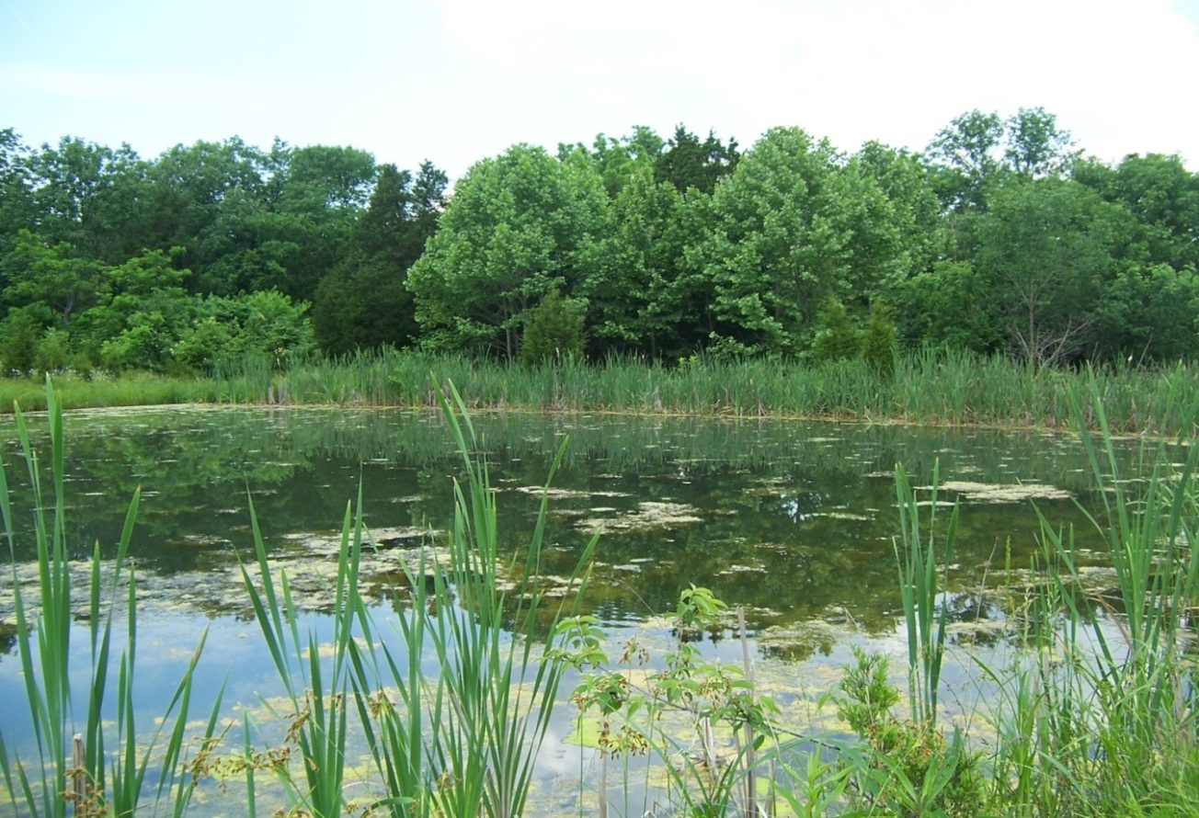
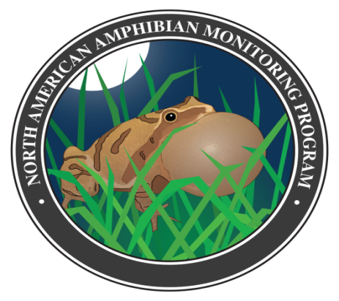
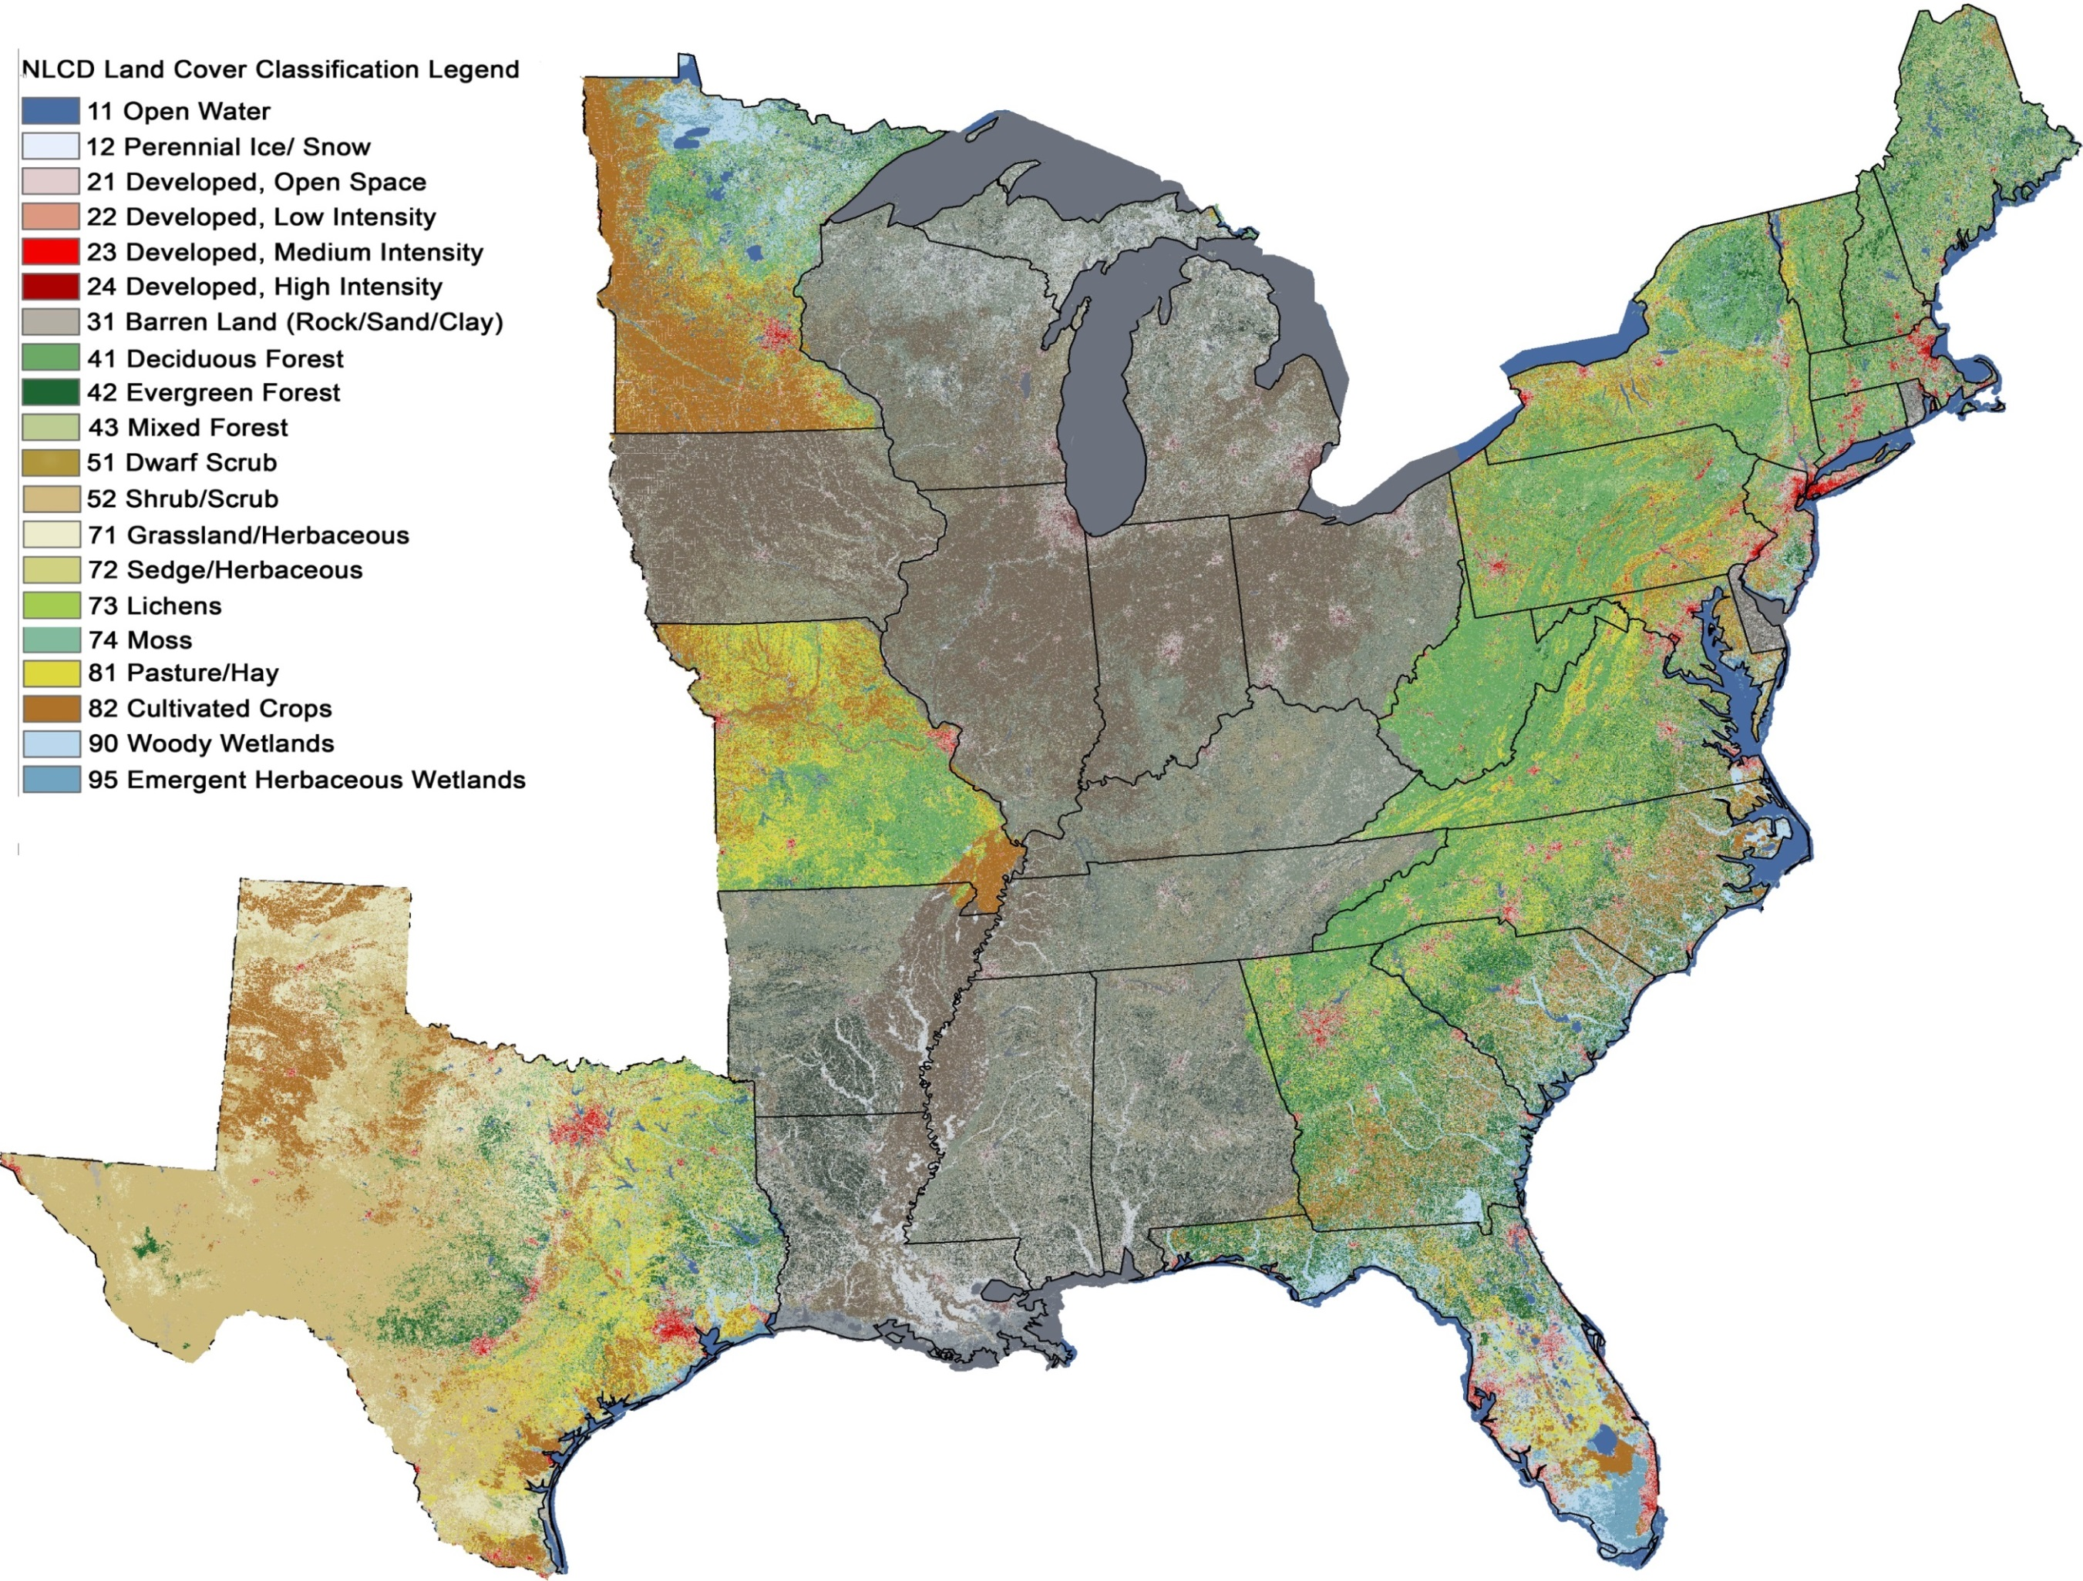
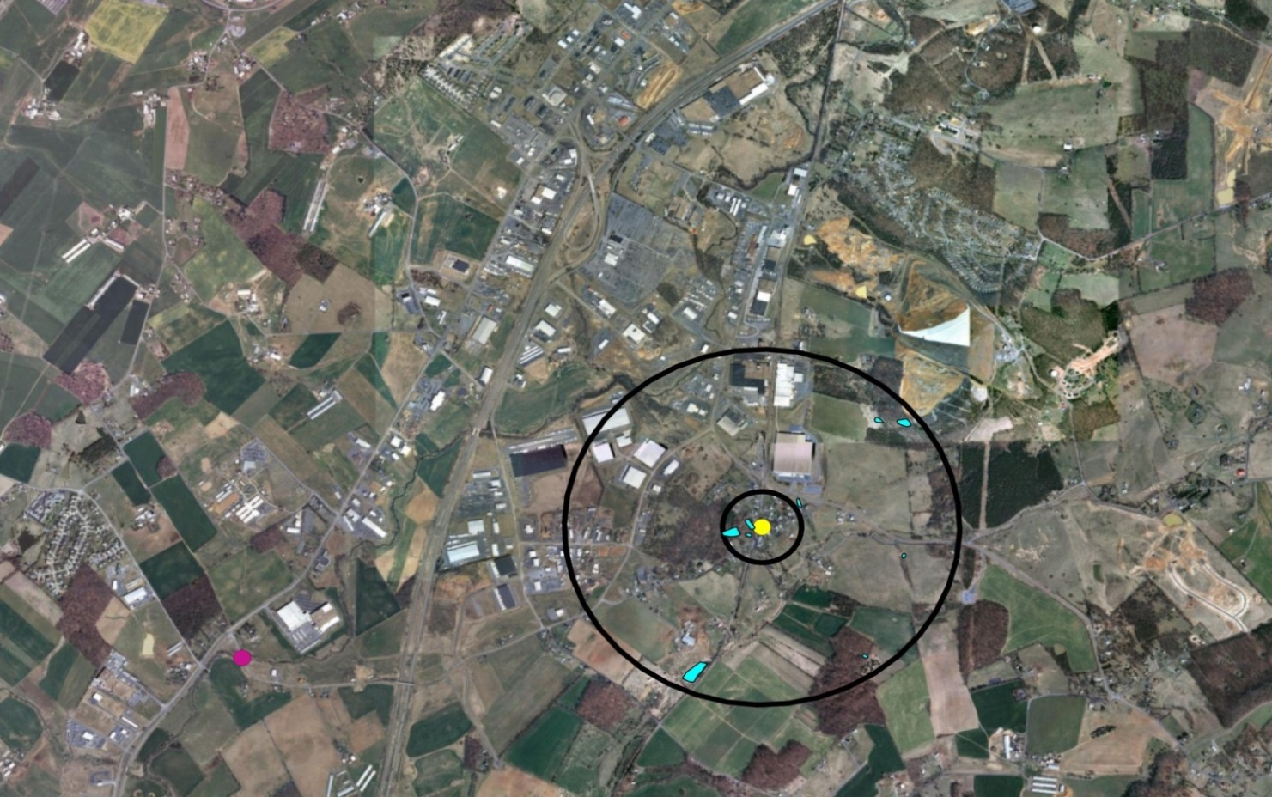
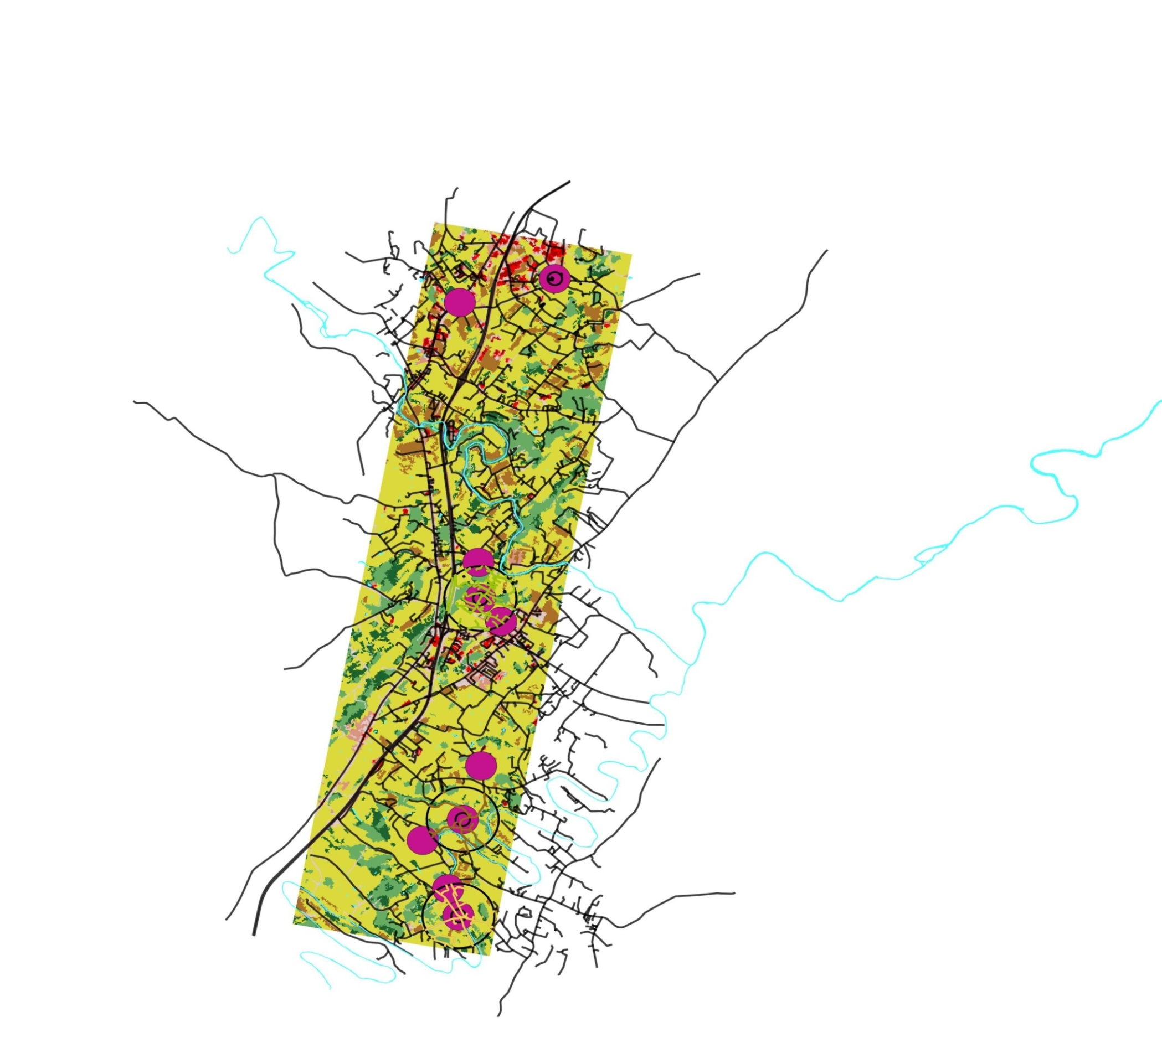
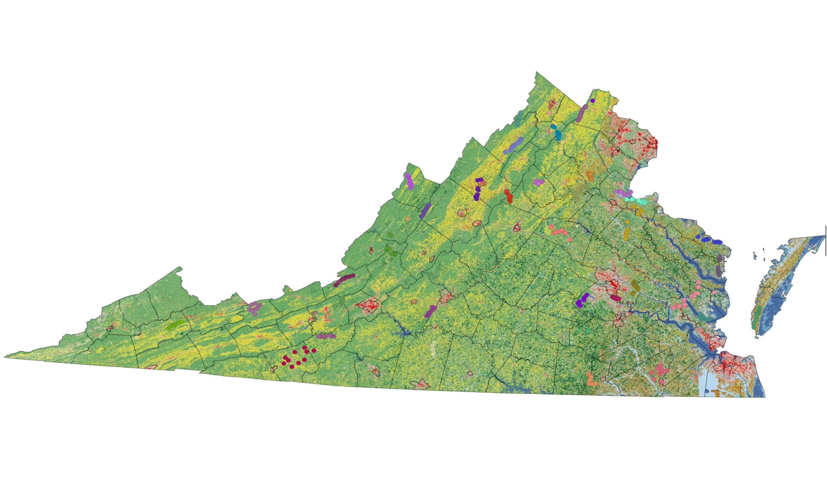
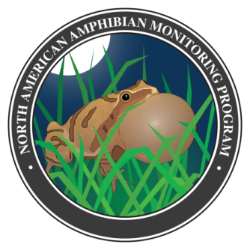


Toads, Roads, and Nodes:
Collaborative assessment of amphibian diversity in the Eastern and Central U.S.A. reveals pervasive effects of roads and traffic
Kristen S. Genet¹, J.J. Apodaca², Christopher Bates³, Jessica Beach⁴, Karen H. Beard⁵, Kelsie Becklin¹, Jane Margaret Bell², Bradley J. Cosentino⁶, Christopher Crockett⁷, Kara Curtain⁸, George Fawson⁵, Jennifer Fjelsted⁷, Elizabeth A. Forys⁹, Melanie Grover², Jaimie Holmes¹⁰, Katherine Indeck⁹, Nancy E. Karraker¹⁰, Eran Kilpatrick³, Tom A. Langen⁴, David Marsh¹¹, Stephen Mugel⁶, Alessandro Molina⁷, James R. Vonesh⁷, Ryan Weaver⁷ and Anisha Willey⁵
(1)Biology, Anoka Ramsey Community College, Coon Rapids, MN, (2)Biology, Warren Wilson College, Swannanoa, NC, (3)Biology, University of South Carolina, Salkehatchie, Allendale, SC, (4)Biology, Clarkson University, Potsdam, NY, (5)Department of Wildland Resources and the Ecology Center, Utah State University, Logan, UT, (6)Biology, Hobart and William Smith Colleges, Geneva, NY, (7)Department of Biology, Virginia Commonwealth University, Richmond, VA, (8)Biology, George Mason University, Fairfax, VA, (9)Environmental Science and Biology, Eckerd College, St, Petersburg, FL, (10)Department of Natural Resources Science, University of Rhode Island, Kingston, RI, (11)Environmental Studies, Washington and Lee University, Lexington, VA
Background
Results
Habitat loss and fragmentation represent significant threats to amphibians. Fragmentation is particularly harmful because many amphibians migrate between aquatic and terrestrial habitats, and even narrow bands of unsuitable habitat can act as barriers to movement. Most previous studies of fragmentation and amphibians have been conducted in single landscapes. We created a network of undergraduate courses to study the relationship between roads, habitat fragmentation, and amphibian distributions across most of the Eastern and Central United States.
Models incorporating local traffic volume and development were the best predictors of amphibian species richness and occupancy by individual species.
Cars cause noise and noise reduces detection, making it difficult to isolate the influence of these factors.
Questions
Species Richness | Best Model | Best Single Variable
All species | FULL | TRAFFIC
All species for surveys without noise | FULL | TRAFFIC
Only species with >90% detection probability | FULL | TRAFFIC
Sites with at least one rare species detected | FULL | TRAFFIC
Noise level has no direct effect on species richness.
What landscape factors best explain amphibian species richness and presence/absence of individual species?
Are the negative effects of roads more associated with the number of roads or with the local volume of traffic?
Are roads or other land uses particularly bad for amphibian populations when they separate wetlands from uplands?
Are amphibians more sensitive to landscape composition or configuration?
High coefficient between noise level and car mean creates difficulties in differentiating them in analyses,
Methods
Amphibian variables: individual species presence, species richness, total number of surveys, number of surveys with noise, and presence/richness variables for surveys without noise.
Students from nine U.S. colleges summarized North American Amphibian Monitoring Program (NAAMP) data in the Eastern and Central U.S. from 1999-2012.
Car mean and road length appear to have independent, negative effects on richness.
Species | Habitat Split Type
Hyla cinerea | DEV
Hyla chrysoscelis/versicolor | DEV
Lithobates sylvatica | DEV, ROADS
3. Landscape variables:
car mean; road length;
proportion developed,
agriculture, or forest;
number of wetlands and
wetland area; habitat richness, adjacent forest, isolated wetland, habitat split and configuration.
GIS used to extract
and compile landscape data for 1620 sites across 14 states.
We found little evidence for significant effects of habitat split by roads, agriculture, or development; with Bonferroni correction, none were significant. In general, landscape composition variables were more useful than configuration variables for predicting amphibian occupancy.
In 10 of 11 species examined, traffic volume was more closely associated with site occupancy than road length, though structural equation models suggested the two factors had effects of similar magnitude.
Analyses
Model Set
Conclusions
Generalized linear models to test hypotheses concerning the influence of landscape variables on amphibian species richness and site occupancy by individual species within 1000m of NAAMP survey locations.
PRESENCE to determine site occupancy in order to build cumulative detection probability curves.
Structural equation modeling to determine correlations between variables affecting species richness.
Model | Variables
FULL | % forest + % developed + wetland area + road length + traffic
ROADS | road length + traffic
DETECT | total surveys + noise level
LANDCOV | FULL w/o traffic
LANDNAT | % forest + wetland area
TOTDEV | % developed + road length + traffic + noise level
Our results suggest that roads, and particularly traffic, exert strong negative effects on calling amphibians across the Eastern and Central U.S., affecting even species that are considered disturbance-tolerant. Our project demonstrates that networks of undergraduate students can be enlisted to analyze large data sets and provide students with a meaningful research experience in large-scale ecology. We plan to continue our investigation by examining landscape connectivity and the scales over which roads and development affect amphibian populations using this collaborative course-based research model.
For more information:
Please visit the project website (https://groups.nceas.ucsb.edu/trn) or contact David Marsh (marshd@wlu.edu) or Kristen Genet (kristen.genet@anokaramsey.edu)

