Slide 1
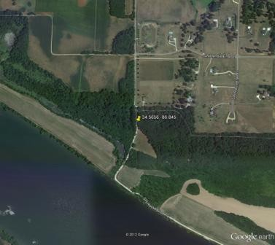
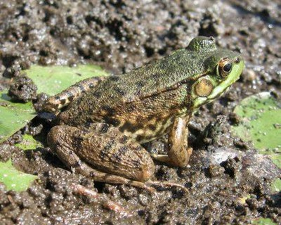
Roads, Toads, and Nodes
Collaborative course-based research on amphibian landscape ecology

Slide 2
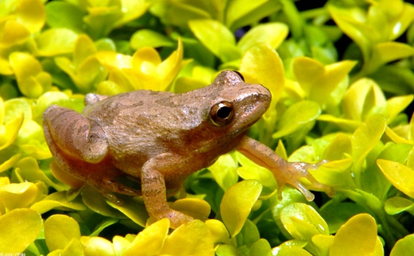
Project goals:
Provide real research experience for students in biology/ ecology courses
Improve students’ ability and confidence in organizing and compiling data
Improve students’ understanding of landscape ecology/ GIS
Generate new findings about the effects of roads and other landscape features on amphibian populations (i.e. do science)

Slide 3
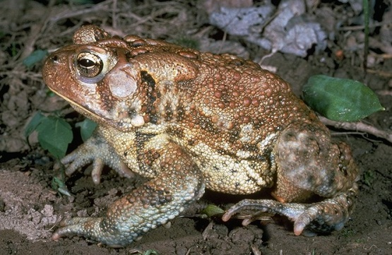
Project structure:
10 classes, each assigned one or more states
Amphibian survey routes divided among students
Two students compile data for each survey route – students compare and seek consensus
Each class analyzes the data for their own state(s)
Representatives from each class come to NCEAS to compile and analyze the group data

Slide 4
Data used in the project:
Data on amphibian presence/absence from volunteer surveys within Eastern and Central North America.
Land use data from the National Landcover database
Wetland data from the National Wetlands Inventory
Road data from TIGER (U.S. Census Bureau)

Slide 5
About the amphibian surveys:
North American Amphibian Monitoring Program, administered by the U.S. Geological Survey
Survey routes, divided into 10 stops
At each stop, the surveyor listens for frog calls
Surveys are generally carried out 3 times per year, sometimes over as many as 10 or 12 years
Survey data are not without error – for example, amphibians may be present but not calling, or people may just confuse the calls of different species
We will work with just 1 of the 10 stops on each route (so that stops are sufficiently far apart)

Slide 6
Your job:
For the routes that have been assigned to you:
Summarize amphibian data for one designated stop
Use GIS software to build a map for the designated stop
Use this map to calculate and record a number of landscape variables (e.g. the density of roads at the stop, the area of wetlands etc.)

Slide 7
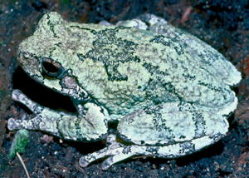
Last year:
Determined relationships between amphibian species richness and several landscape factors (roads, traffic, development, wetland area, forest), all measured within 1 km of NAAMP stops

Slide 8
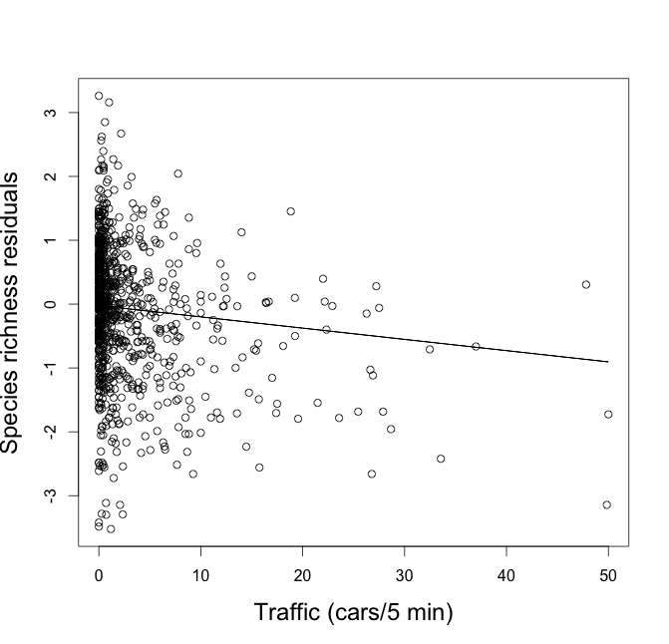

Slide 9
Influence of deicing salts??? (figure from J. Vonesh, VCU)

Slide 10
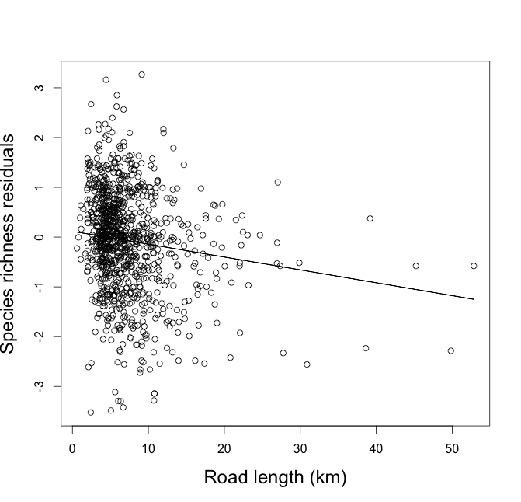

Slide 11
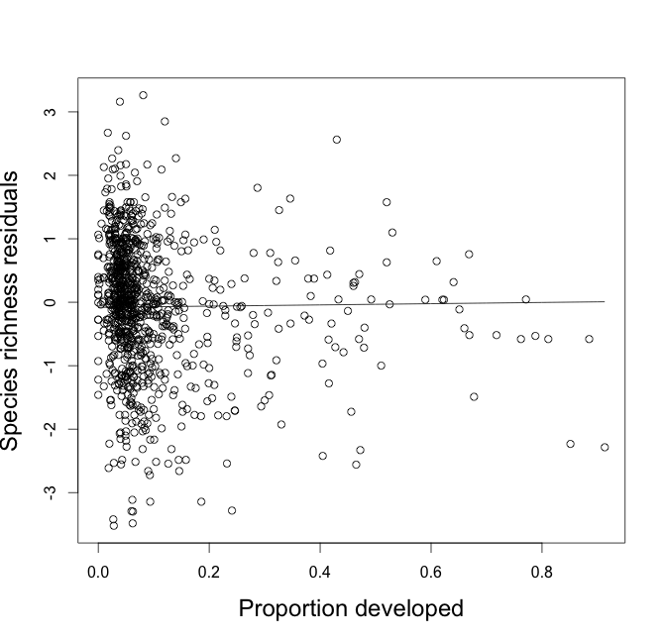

Slide 13
Individual species results
Species | Model | Terms | ω
Anaxyrus americanus | Full | road length, traffic, development, forest, wetland area | 0.791
Hyla chrysoscelis/versicolor | Full | road length, traffic, development, forest, wetland area | 0.641
Hyla cinerea | Full | road length, traffic, development, forest, wetland area | 0.997
Hyla gratiosa | Full | road length, traffic, development, forest, wetland area | 0.382
Lithobates catesbeiana | Full | road length, traffic, development, forest, wetland area | 0.975
Lithobates clamitans | Full | road length, traffic, development, forest, wetland area | 0.973
Lithobates palustris | Total development | road length, traffic, development, noise | 0.305
Lithobates sphenocephalus | Natural land cover | forest, wetland area | 0.688
Lithobates sylvatica | Full | road length, traffic, development, forest, wetland area | 0.704

Slide 14
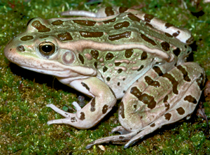
This year:
Examine factors which were important last year (e.g. road density, development, wetland area, forest, agriculture) and find out the scale over which they most affect amphibians

Slide 15
Why?
Knowing scale of effects is important for conservation planning
Knowing scale of effects is helpful for designing future studies and monitoring programs
Knowing scale of effects is useful for understanding mechanism (e.g. do roads just cause roadkill or do they isolate populations)

Slide 16
Scales to be analyzed
300 m – local scale, “Core terrestrial habitat” from Semlitsch and Bodie (2003)
600 m – data show most frogs (>90%) are found within this distance from ponds (Rittenhouse 1999)
1 km – allows comparison with results from last year
5 km – meta-population scale, about the maximum biologically relevant scale
10 km – a sort of a negative control; in principle, associations should decline at this distance since no frogs go this far

Slide 17
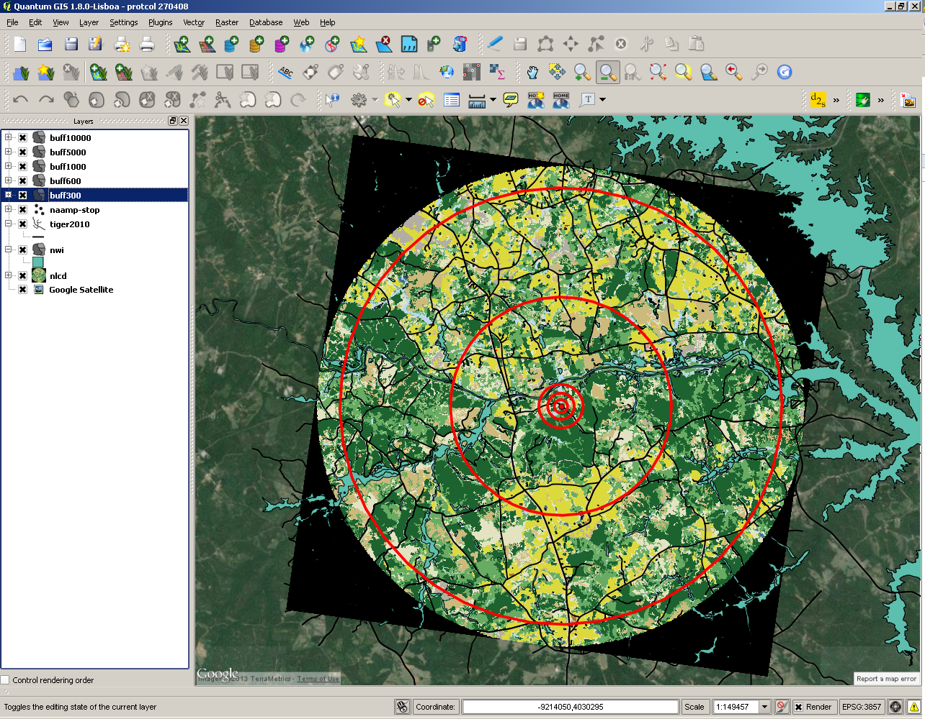

Slide 18
Variables to be measured at each scale
Road density (split into different road types)
Proportion of land “developed”
Proportion of land agricultural (row crops)
Proportion of land forested (effects expected to vary among species)
Wetland area
Wetland and upland habitat connectivity
(be happy, last year we had at least twice this many)

Slide 19
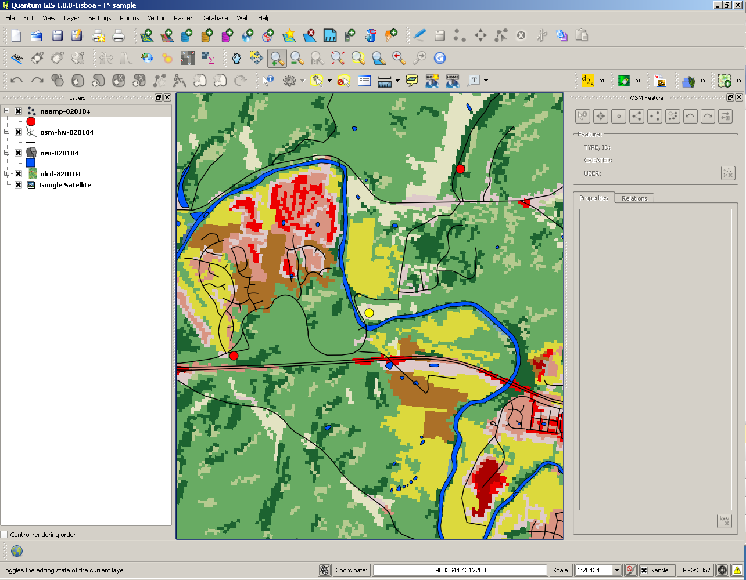

Slide 20
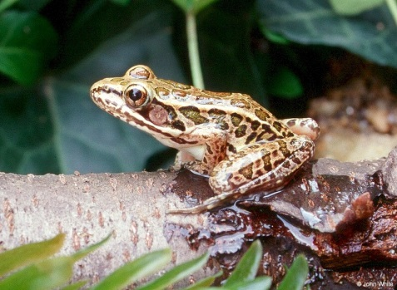
Additional questions:
Does road type (primary, secondary, rural) matter, or do all roads have similar effects?
Does intensity of development matter, or is all development functionally similar?
Is landscape connectivity important, and does connectivity need to take into account terrestrial habitats?

Slide 21
Caveats/limitations to consider
Frog data collected by volunteers, quality is variable
Difficult (but not impossible) to separate detection from presence/absence
Landcover data is only about 80% accurate
NAAMP sites are all located along roads (would be nice to have some roadless sites)

Slide 22
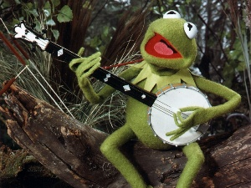
But, also some real positives:
Huge datasets to work with
Geographic coverage allows for very general conclusions
Experience from last year in knowing what we can and can’t measure
Lots of expertise and support

Slide 23
Some frequently asked questions:
Q: Why me? (why us?)
A: Your class has been selected because of your instructor’s expertise on the subject matter.
Q: What’s the point of having two people do each stop? Isn’t that needlessly repetitive?
A: Having two people do each route is the only way we know if the results coming back in are valid. Even very experienced scientists frequently build in this kind of replication to validate their results.
Q: There’s no way I can do all this. (OK, this is not really a question).
A: You can do this! Students last year felt the same way, but they figured it out.
Q: What if I can’t figure something out?
A: We know you’ve never done this before and we expect that everyone will have questions. If you can’t figure something out, post your question on the Discussion Board, or ask your instructor. It’s OK to leave entries blank, but please don’t guess (or estimate) if you haven’t been able to figure something out.

Slide 24
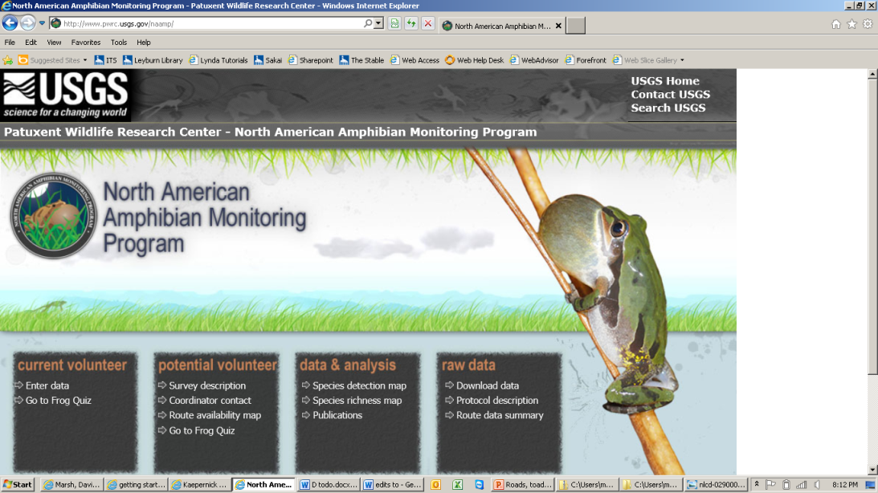


Thanks in advance for all your hard work on this project!

